Slide 1
Data Structures and Algorithms -3 (25CS2103E)
LOG ANALYSIS SYSTEM
Team Members
M.AVISHYA : 2520030482
K.PRAGNYA : 2520030430
G.VARSHINI : 2520030017
Under the Esteemed Guidance of
Dr. CH . ANURADHA

Slide 2
Contents
Abstract
Introduction
Literature survey
Problem Statement and Objectives
Hardware and Software requirements
Results
Conclusion
Future Scope

Slide 3
Abstract
The Log Analysis System is designed to identify recurring error patterns from massive server log files efficiently. The system analyzes continuous streams of log data and searches for predefined error signatures using efficient string-matching algorithms. It detects repeated errors and categorizes them based on their frequency and severity level. The system can handle large datasets without requiring administrators to manually inspect every log entry. It continuously monitors log files to identify new errors as they occur. The detected errors are organized into meaningful categories such as low, medium, and high severity.
Summary reports are generated to provide information about frequently occurring errors and their impact on the server. The system helps administrators identify recurring faults and understand their possible causes. Efficient searching techniques improve the speed of error detection and reduce processing time.

Slide 4
Introduction
In modern computing environments, servers generate millions of log entries every day to record system activities, user requests, errors, and security events. Analyzing these large log files manually is time-consuming and may cause important errors to be missed.
A Log Analysis System provides an automated solution for processing and analyzing server logs. It searches the logs for predefined error patterns or signatures and identifies matching entries using efficient string-matching algorithms.
The system categorizes detected errors according to their frequency and severity, making it easier to identify the most critical and recurring problems. It also supports continuous log monitoring, allowing newly generated errors to be detected quickly.
The analyzed results are presented as matched logs and summary reports, helping system administrators understand server problems more effectively. By reducing manual effort and improving the speed of error detection, the system supports quick fault diagnosis, better server monitoring, and improved system reliability.

Slide 5
Literature Survey
Log Files
Large server log files containing system activities and events.
May include timestamps, IP addresses, user activities, warnings, and error messages.
Logs can be in formats such as .log, .txt, or other structured formats.
Predefined Error Patterns
A collection of known error messages or signatures that the system needs to search for.
Examples: Connection refused, File not found, Database error, Authentication failed.
These patterns help the system quickly identify known problems.
Severity Information
Error patterns can be associated with severity levels such as Low, Medium, High, and Critical.
This helps administrators prioritize important errors.
Monitoring Input
For continuous monitoring, newly generated log entries are continuously provided to the system.
The system analyzes new entries as they appear and detects matching error patterns.

Slide 6
Matched Logs are the log entries that contain one or more of the predefined error patterns or signatures.
The system provides:
Matched error message – the detected error from the log.
Timestamp – when the error occurred.
Error pattern/signature – the predefined pattern that matched.
Frequency – number of times the same error occurred.
Severity – Low, Medium, High, or Critical.
Source information – server, application, or service where the error occurred.
Summary report – a consolidated list of recurring errors and their frequencies.
Example:
2026-08-24 10:30:15 | Database Connection Failed | Frequency: 25 | Severity: High
This output helps system administrators quickly identify recurring and critical faults in the server.

Slide 7
Constraints: Millions of Log Entries
The system must be capable of processing **millions of log entries** efficiently without significant performance degradation.
Key constraints include:
Large data volume: Logs may contain millions of records and require efficient processing.
Fast searching: String-matching algorithms should quickly identify predefined error patterns.
Memory efficiency: The system should avoid loading the entire log file into memory at once.
Scalability: It should handle increasing log sizes without major performance issues.
Continuous monitoring: New log entries should be processed continuously as they are generated.
Accurate detection: Matching should identify relevant errors while minimizing false matches.
Efficient reporting: Summary reports should be generated without repeatedly scanning the entire dataset.

Slide 8
Problem Statement and Objectives
Modern servers generate millions of log entries, making manual analysis slow, difficult, and error-prone.
The proposed Log Analysis System analyzes server log files by searching for predefined error patterns or signatures using efficient string-matching algorithms.
The system identifies matching log entries and categorizes detected errors based on their frequency and severity.
It also supports continuous log monitoring so that newly generated errors can be detected quickly.
The system takes log files and predefined error patterns as input and produces matched logs, recurring error patterns, frequency/severity information, and summary reports as output.
The main challenge is to process millions of log entries efficiently while minimizing processing time and memory usage.
The objective is to help system administrators quickly diagnose faults, monitor server health, and reduce the effort required for manual log analysis.

Slide 9
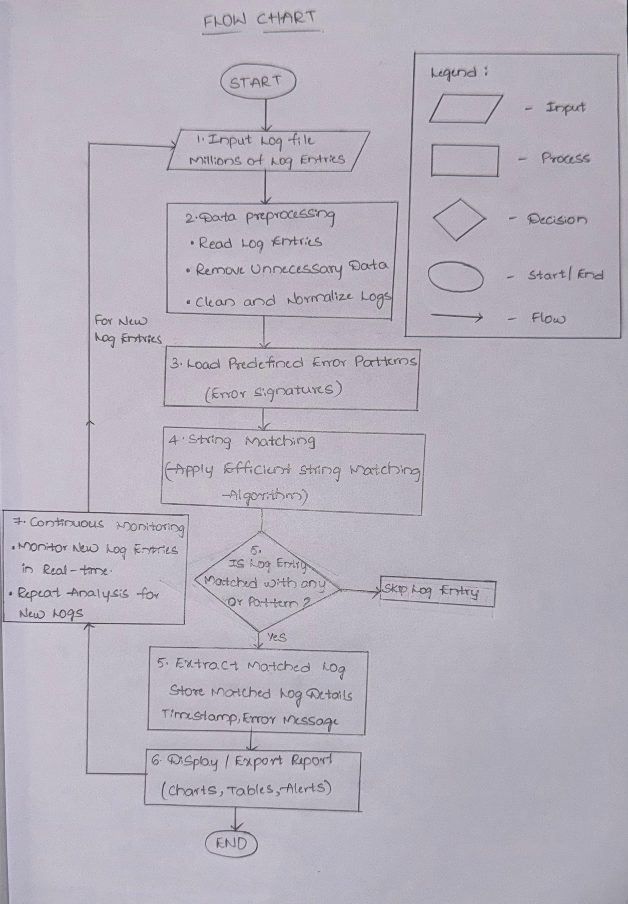
Flow Chart

Slide 10
Results
The implemented Log Analysis System provides the following results:
Successfully processes large volumes of server log entries.
Detects predefined errors such as database connection failures, authentication failures, connection timeouts, and out-of-memory errors.
Identifies and displays matched log entries.
Calculates the frequency of recurring errors.
Records important information such as timestamp, error message, source, and severity.
Classifies errors into levels such as INFO, WARNING, ERROR, and CRITICAL.
Generates summary reports containing error type, frequency, severity, and timestamps.
Supports continuous monitoring of newly generated log entries.

Slide 11
Hardware and Software requirements
Hardware Requirements
Processor: Intel Core i3 or above
RAM: Minimum 4 GB, recommended 8 GB
Storage: Minimum 10 GB free space
System: Laptop/Desktop
Internet: Required for downloading datasets and software packages
Software Requirements
Windows / Linux / Ubuntu
Python 3.x
VS Code / PyCharm
Flask
Pandas
Matplotlib
SQLite / MySQL
Git/GitHub
Web Browser

Slide 12
Conclusion
The Log Analysis System helps system administrators analyze millions of server log entries quickly and easily. It uses efficient stringmatching algorithms to find predefined error patterns, count their frequency, and classify them based on severity. The system reduces manual effort and analysis time and helps administrators identify recurring and critical errors faster. Continuous log monitoring also allows new errors to be detected as they occur. Overall, the system helps administrators quickly identify problems and improve server reliability.

Slide 13
Future Scope
Real-time monitoring: The system can watch logs continuously and show new errors immediately.
AI integration: AI can be used to find unusual errors automatically.
Error alerts: The system can send alerts when a serious error occurs.
Better reports: More detailed charts and reports can be added.
Cloud support: The system can analyze logs stored on cloud servers.
Failure prediction: It can predict possible system problems before they happen.
More log formats: It can support logs from different servers and applications.
Automatic problem finding: The system can help identify the main reason for an error.

Slide 14
Thank you

